Slide 1
Neural Network Graph Classifier
Patrick Spohr

Slide 2



Outline
03 Motivation – Why choose this project and what literature is there?
11 Objective – What do I want to accomplish?
18 Data – Where am I getting the data?
CIFAR-10 Images
Scraped Graphs
Generated Graphs
28 Methods – How do I achieve my objectives?
CNN, TensorFlow, and Python
Simple Graph Classifiers
Distribution Graph Classifiers
54 Results – Can the models accurately classify the images?
Simple Graph Classifiers
Distribution Graph Classifiers
81 Conclusion – What are my final thoughts and further research?

Slide 3

Motivation

Slide 4

Motivation
Graphs are everywhere…
And can depict many things…

Slide 5
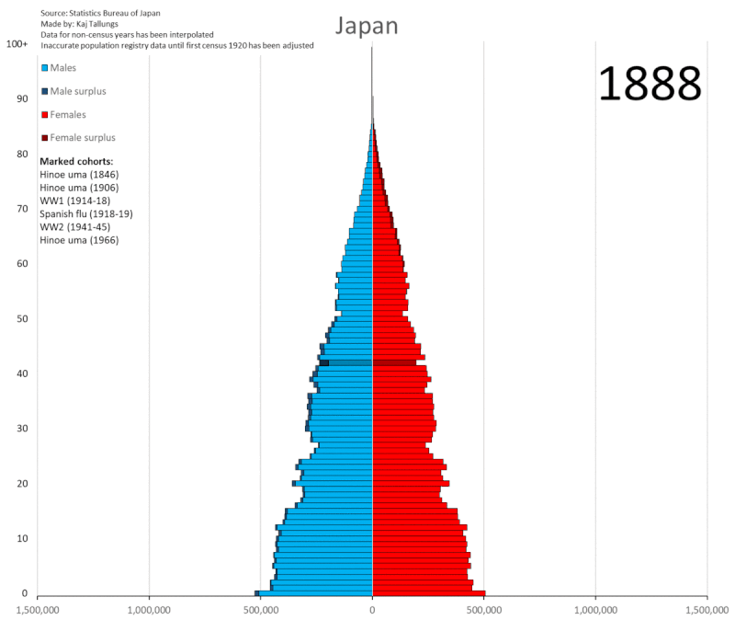
Motivation
I like graphs because like paintings, they too can tell a story.
By Kaj Tallungs - Own work, CC BY-SA 4.0, https://commons.wikimedia.org/w/index.php?curid=107393925

Slide 6
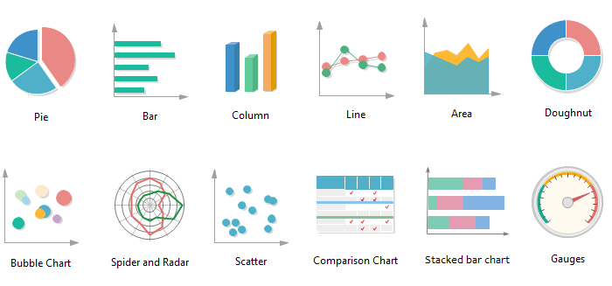
Motivation
[Li]
Being able to quickly identify graphs is important as there are many to choose from.

Slide 7
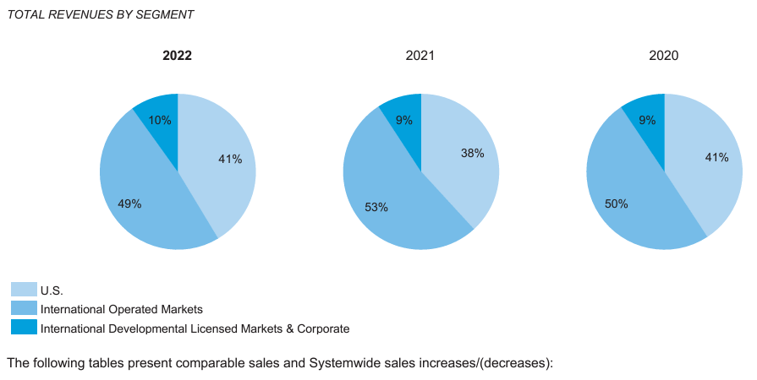
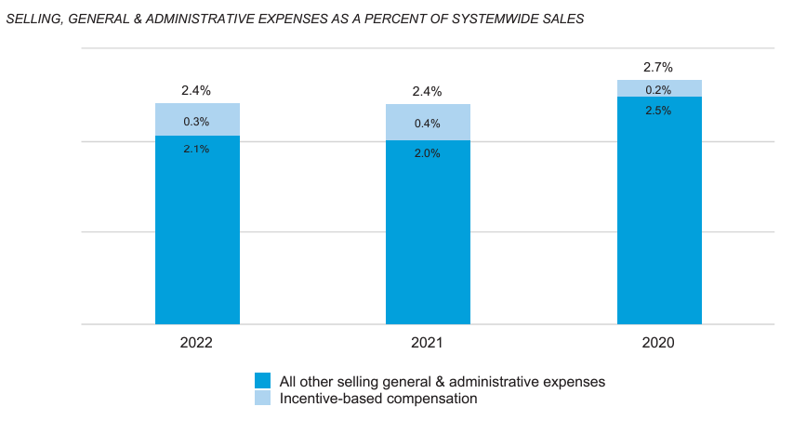

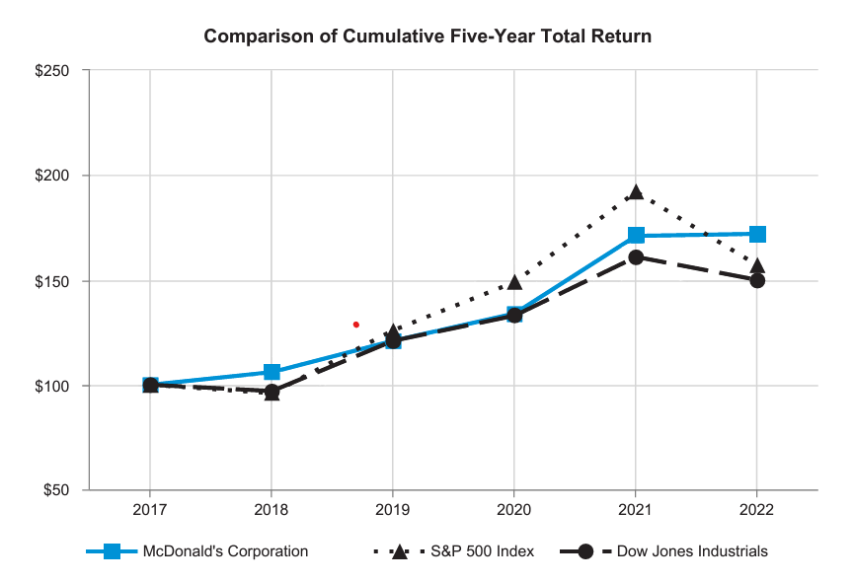
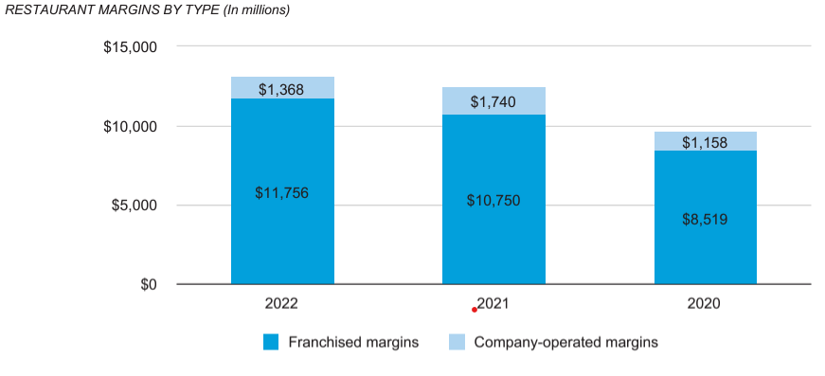
Motivation
Graphs make it quick and easy to interpret a large amount of information.
McDonald’s Annual 2022 Report has 73 pages and 8 graphs.
[McDonald’s]
p. 16
p. 13
p. 25
p. 15

Slide 8
Motivation
What’s the possible use case of being able to identify graphs in McDonald’s Annual Report?
Identify
Locate
Organize
Is it a graph?
Where are they?
What type of graph?
Yes
Report
pie chart, bar chart…
Classify graph
Pages 13, 15, 16, 25
Organize and show
MY FOCUS

Slide 9
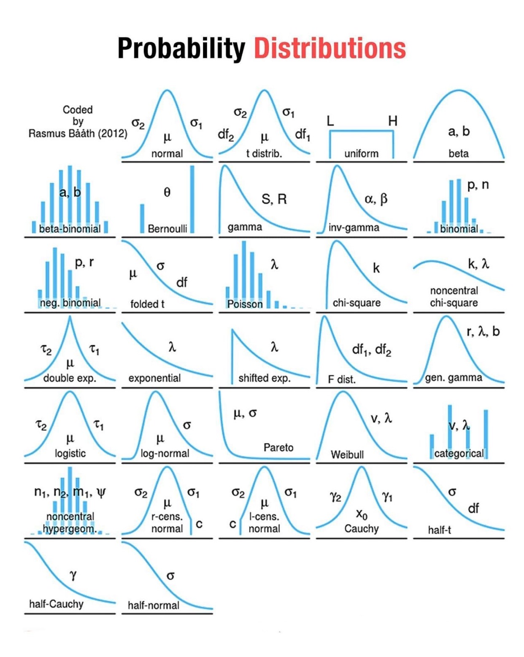
Motivation
I chose to classify the distributions in the graph since I didn’t find any similar projects.
[SandhyaKrishnan02]

Slide 10
Literature Review
Review of neural networks and image classification
While there are many image classification research, I didn’t find anything regarding the classification of graphs with probability distributions.
CS231n. (2023). (Stanford University) Retrieved January 2024, from Convolutional Neural Networks for Visual Recognition: https://cs231n.github.io/convolutional-networks/
O'Shea, K., & Nash, R. (2015). An Introduction to Convolutional Neural Networks. Aberystwyth University. Retrieved from https://arxiv.org/abs/1511.08458

Slide 11
Objective

Slide 12
Objective
Goals of the Project
First
Identify a graph from other images.
Second
Classify the graph.
Distributions
Normal
Log-Normal
Exponential
Uniform
MY FOCUS
Identify
Is it a graph?
Yes
Classify Graph

Slide 13
Objective
Goals of the Project
Workflow of the project...
Get Data
Graph Classifier
Distribution Classifier
Model Evaluation
Get 1000s of graphs of different types and distributions
Get 1000s of natural images for graph classifier
Create first model to identify whether an image is a graph or not
Create second model to classify graphs based on their probability distributions
Optimize models and check validation accuracy

Slide 14


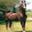
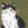
CIFAR-10
Objective
Hurdles to Overcome
Natural Images Data
car
airplane
horse
cat
Getting natural images is easy because of quantity and quality of sources.
[Krizhevsky]

Slide 15
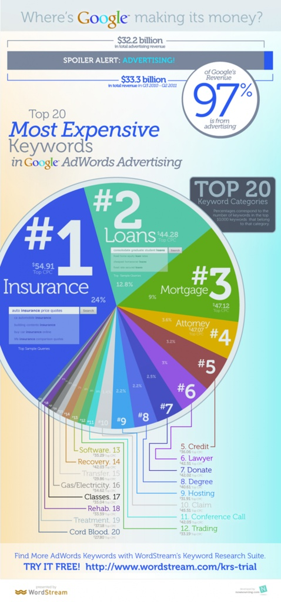
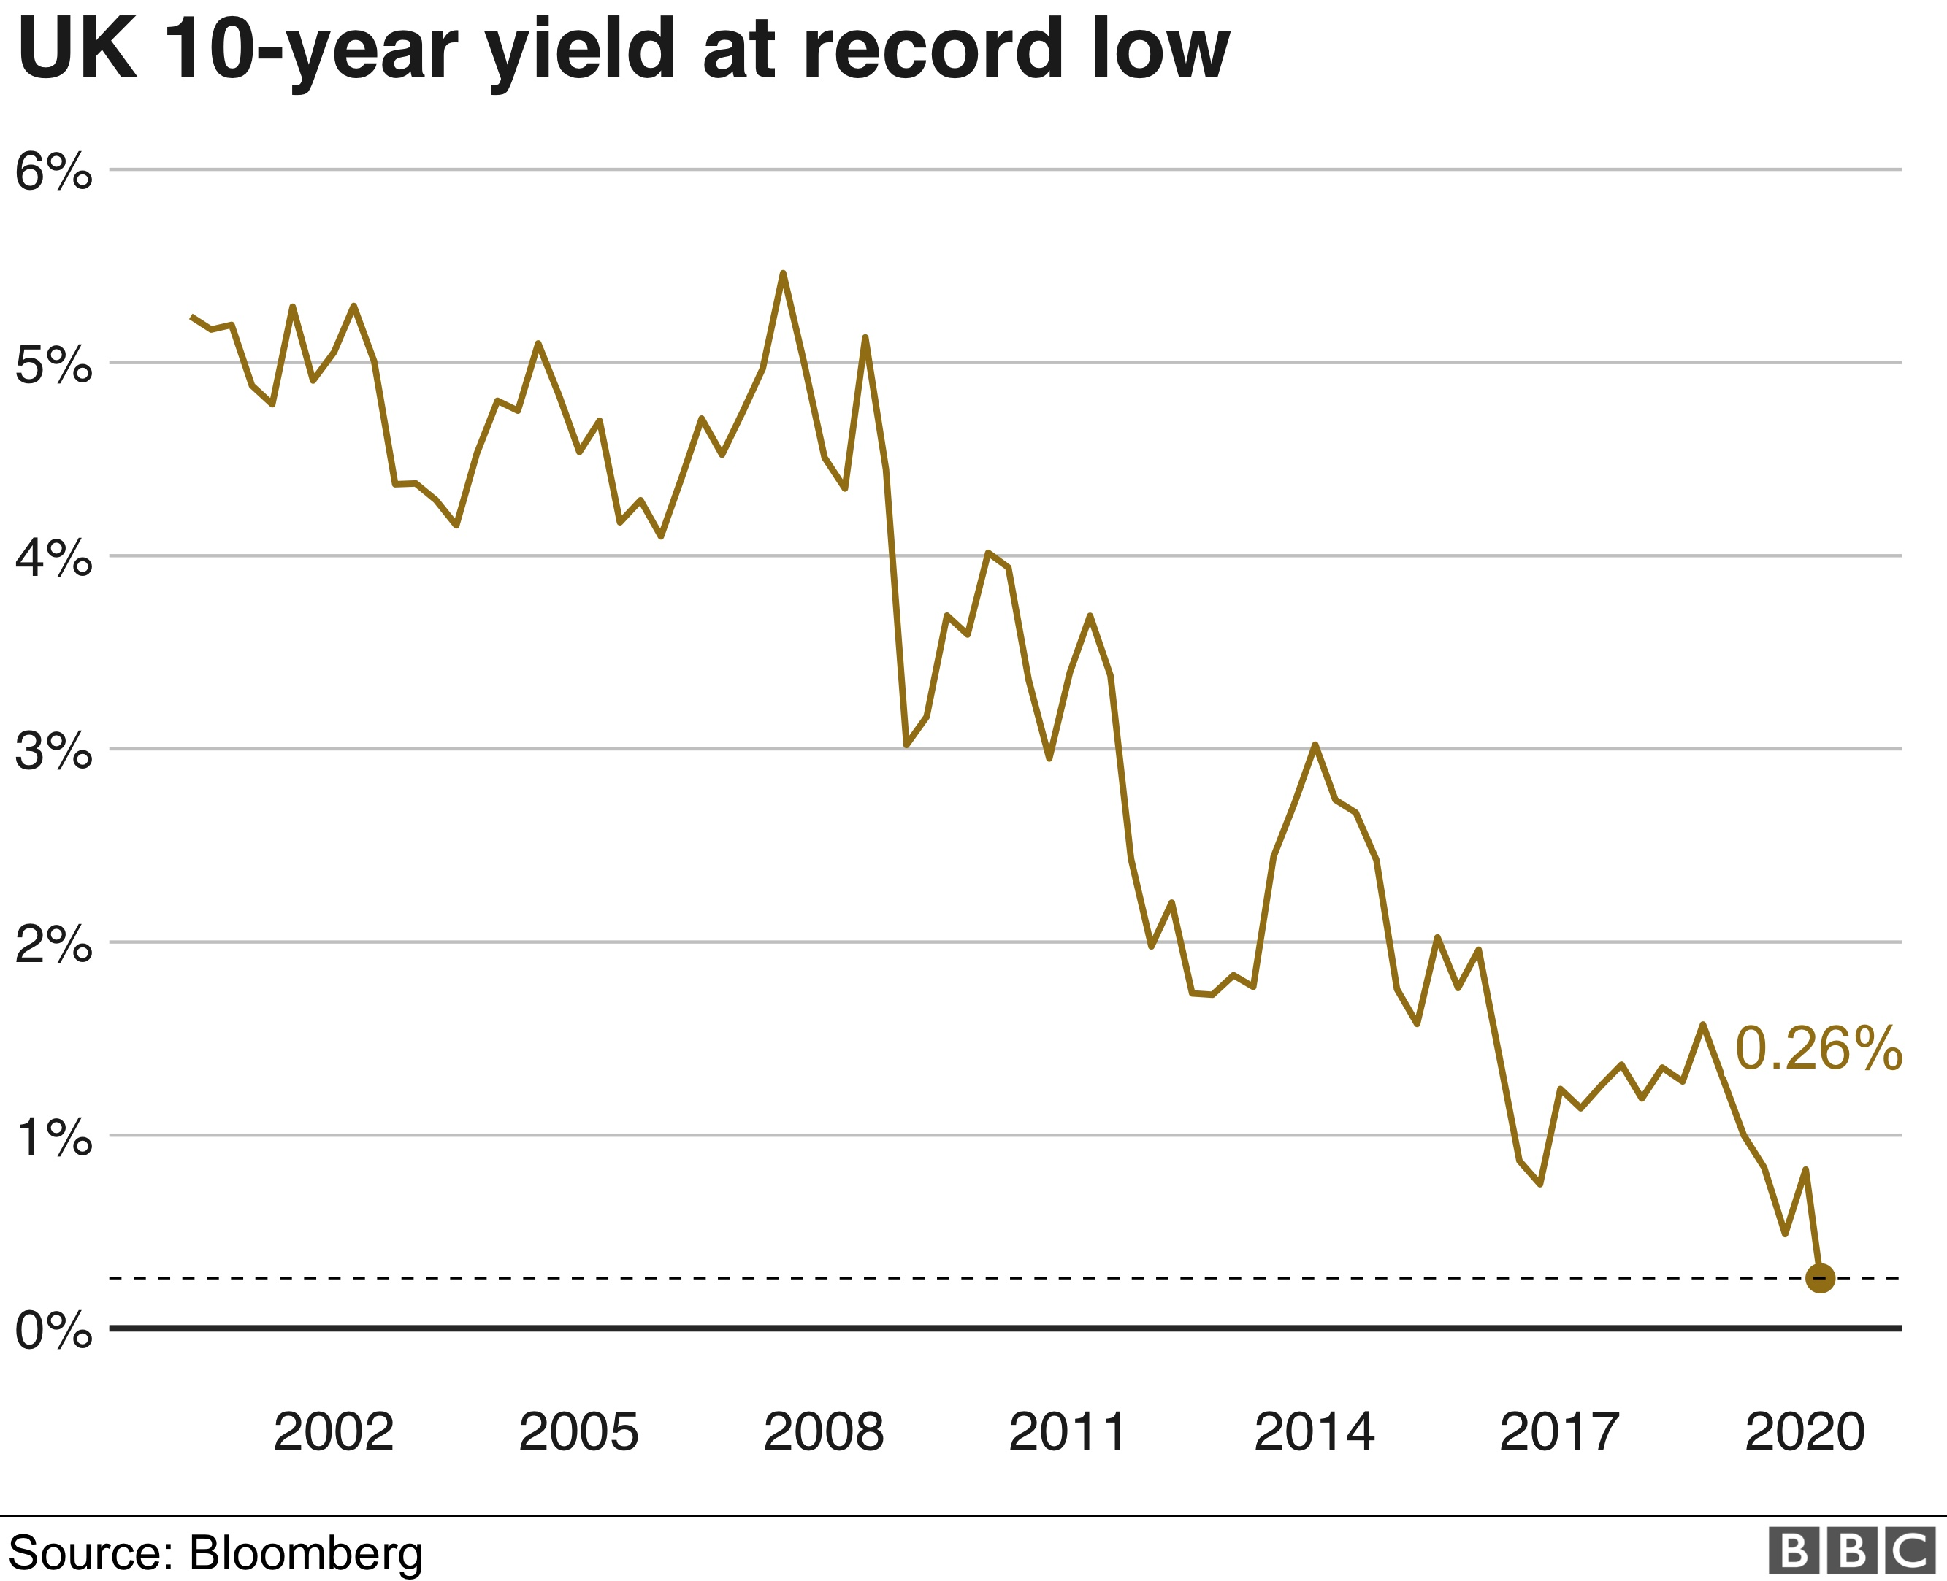
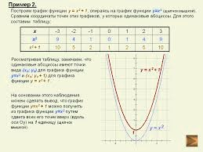
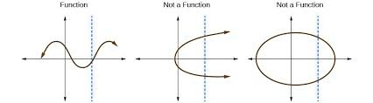
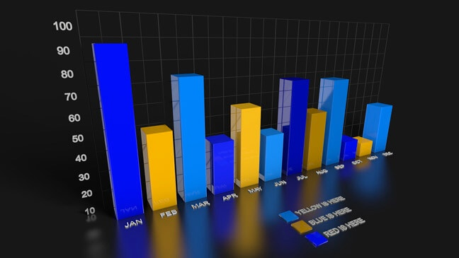
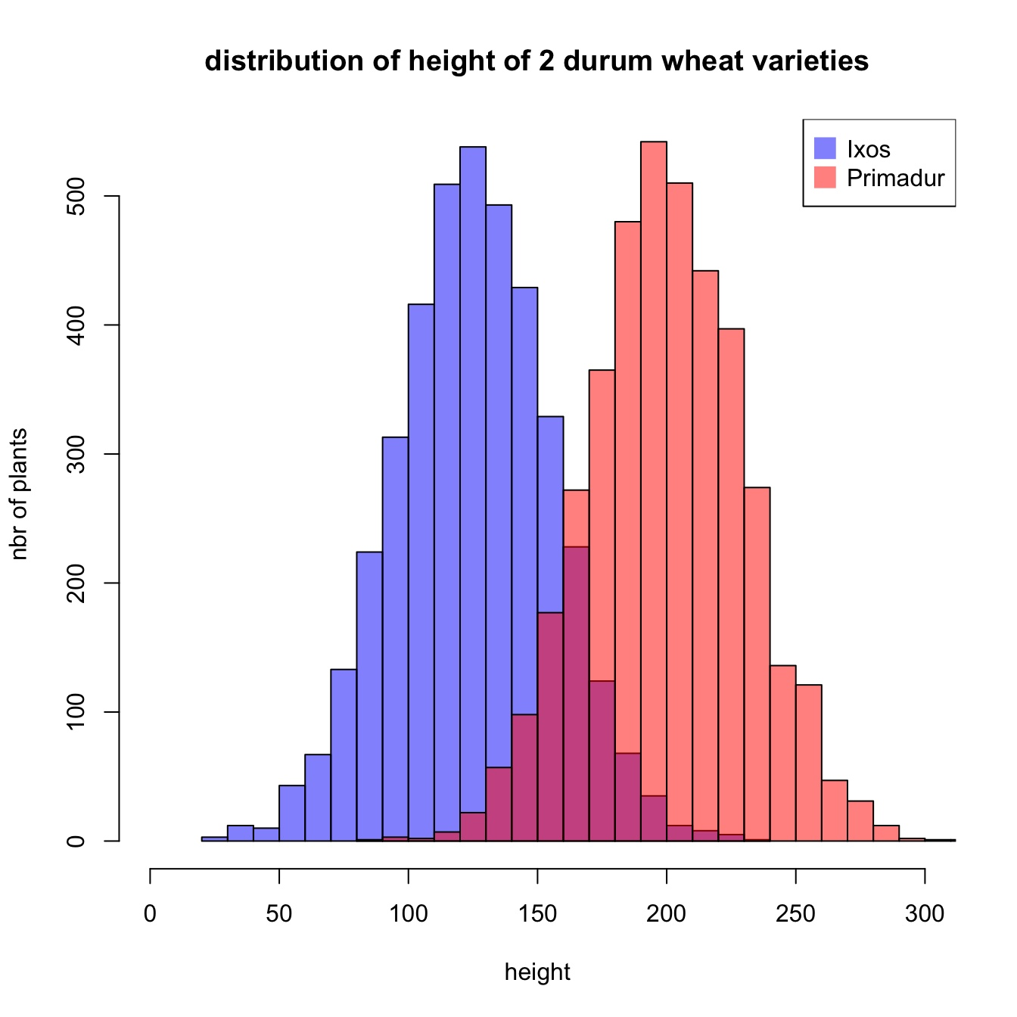
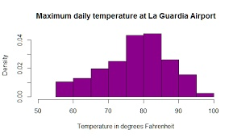
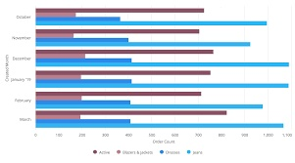
Objective
Hurdles to Overcome
Where can I get the graph images?
kaggle.com
[SunEdition]

Slide 16
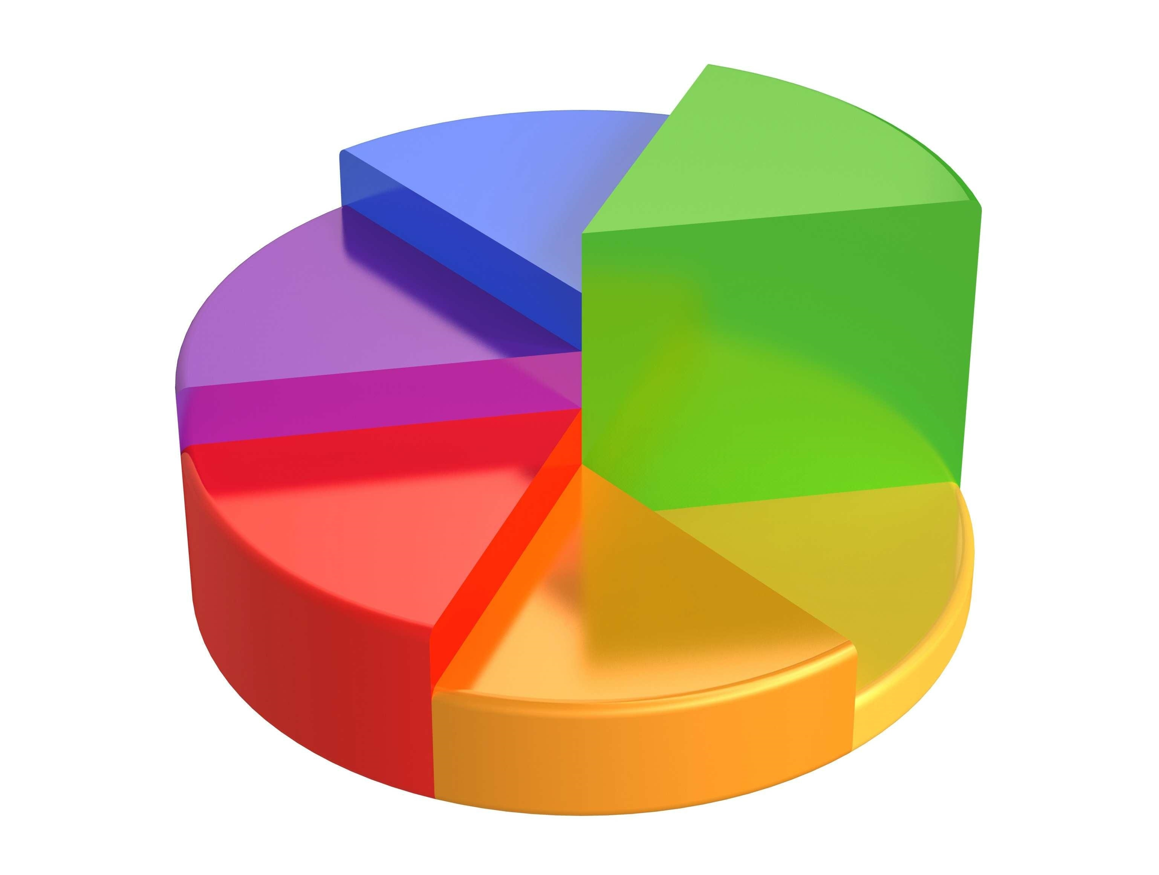
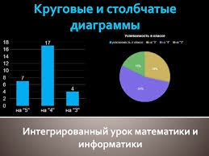
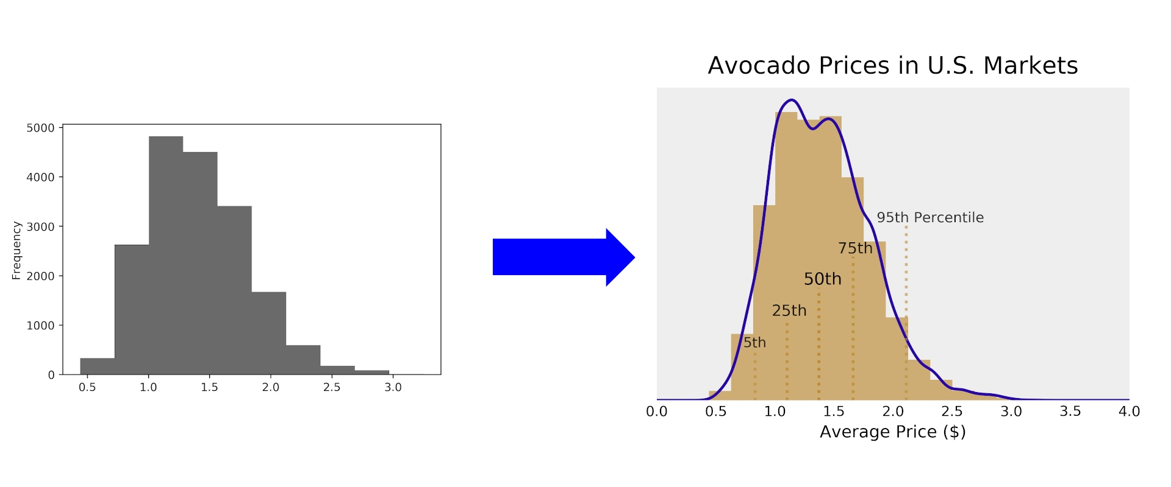
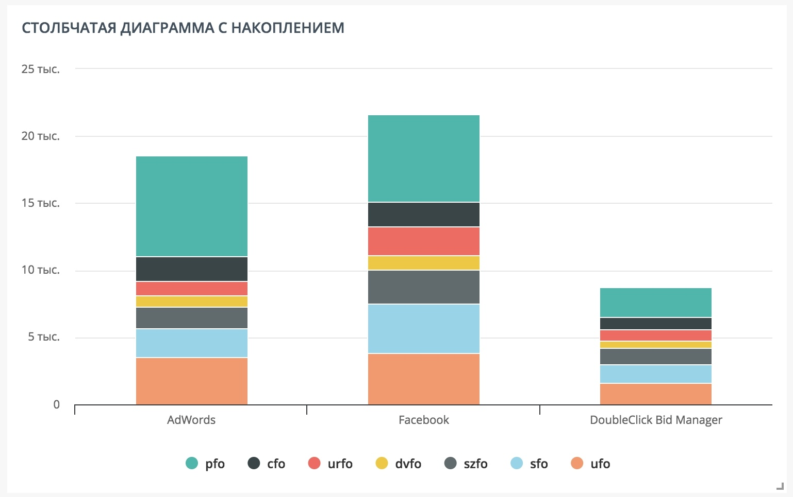
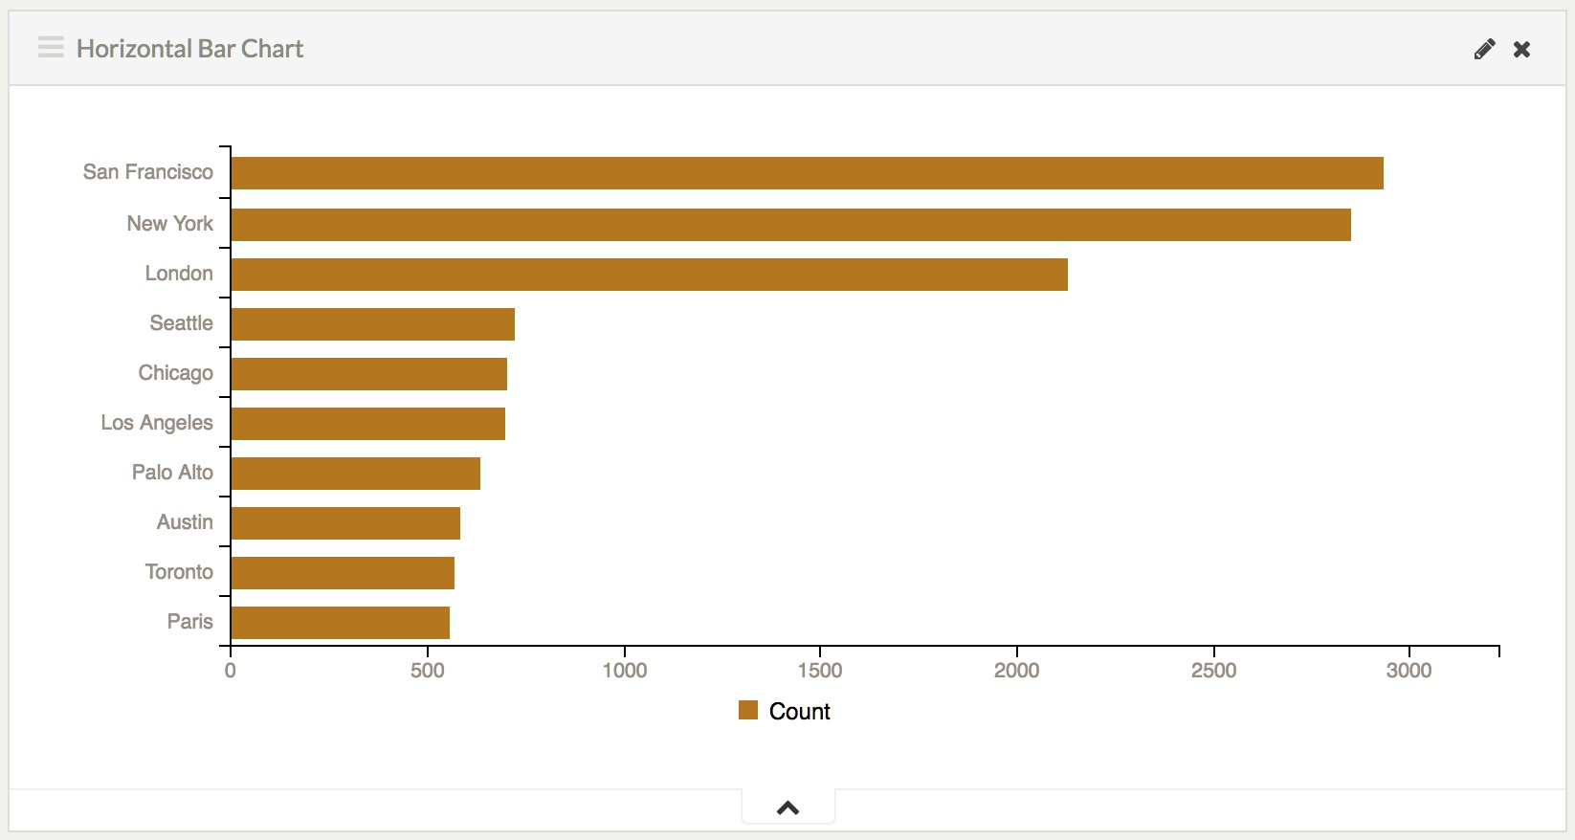
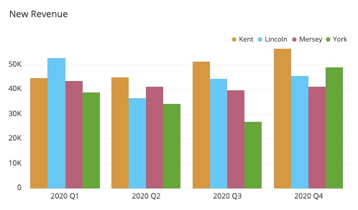
Objective
How to determine the type of a graph?
Hurdles to Overcome
Bar chart, line chart, histogram, and log-normal distribution
Two charts in one image
“Graph-like” images
Bar Chart Types
Stacked bar chart
Horizontal bar chart
Vertical bar chart
[SunEdition]

Slide 17
Objective
Hurdles to Overcome
The Biggest Hurdle…
Could not find suitable dataset with probability distribution graphs.
# Solution One - Scraped
Scrape the graphs from a website, but I would run into the issue of where to scrape and how to label them time efficiently.
# Solution Two - Generated
Use a graphing library to generate randomized graphs.
This is the most time effective solution that will lead to hopefully similar results.

Slide 18
Data

Slide 19
Data
3 Data Sources
CIFAR-10
Generated Graphs
Natural images of different types of objects, animals, and people
Graphs with different probability distributions.
Created using a language library.
Scraped Graphs
Graph dataset scraped from various sources which weren’t stated.

Slide 20
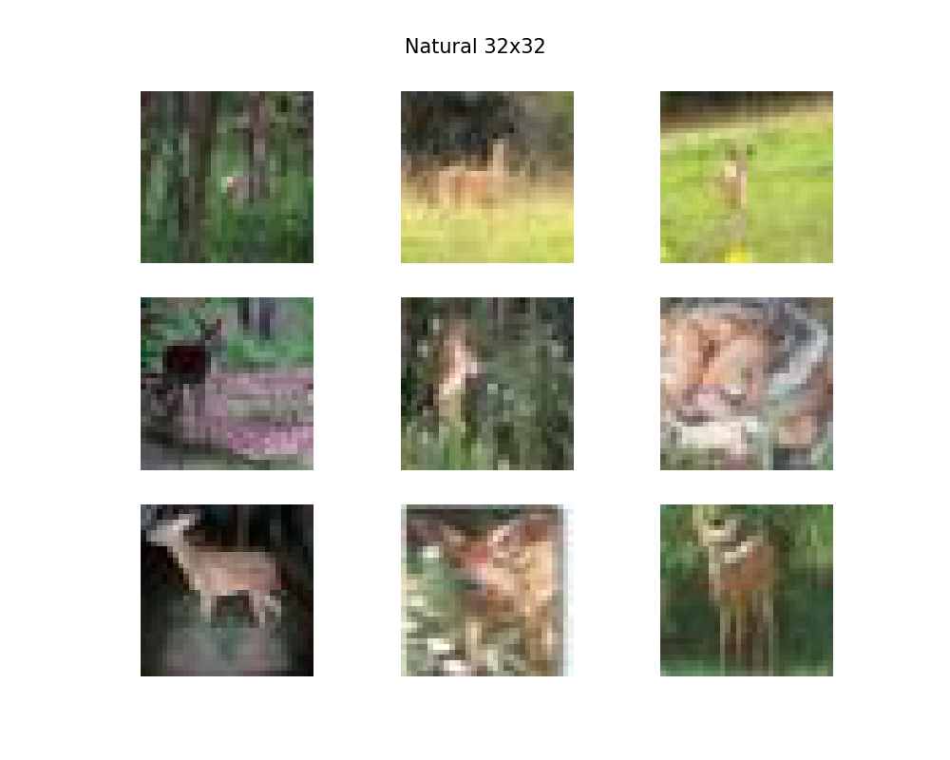
Data
CIFAR-10 Images
CIFAR-10 Overview (CIFAR)
Canadian Institute For Advanced Research
Count – 60,000
Dimensions – 32x32
Format – flat NumPy array
Shape – (3072,)
10 Classes – airplane, automobile, bird, cat, deer, dog, frog, horse, ship, and truck
Updated
Count – 10,000 (first batch)
Dimensions – 32x32
Format – JPG
Shape – (32, 32, 3)
10 Classes – airplane, automobile, bird, cat, deer, dog, frog, horse, ship, and truck
[Krizhevsky]

Slide 21
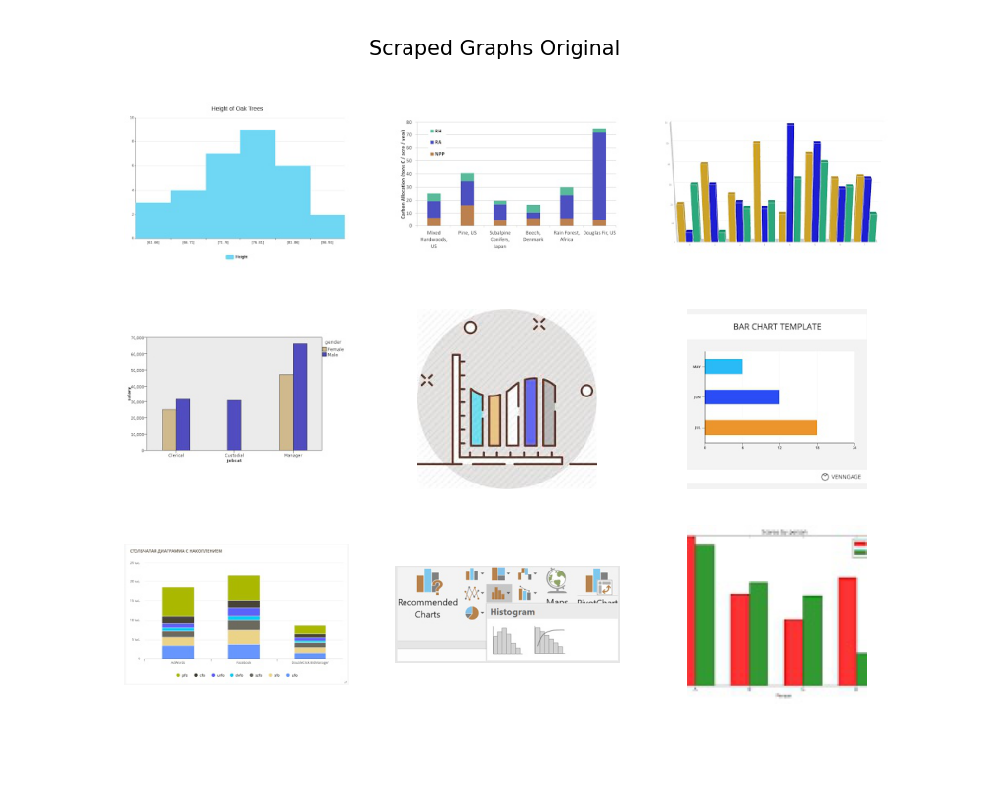
Data
Scraped Graphs
Scraped Overview (SCP)
[SunEdition]
Count – 15,786
Dimensions – various
Format - JPG
8 Classes – just image, bar chart, diagram, flow chart, graph, growth chart, pie chart, table
Updated
Count – 7,753
Dimensions – 32x32
Format - JPG
4 Classes – bar, diagram, graph, pie

Slide 22
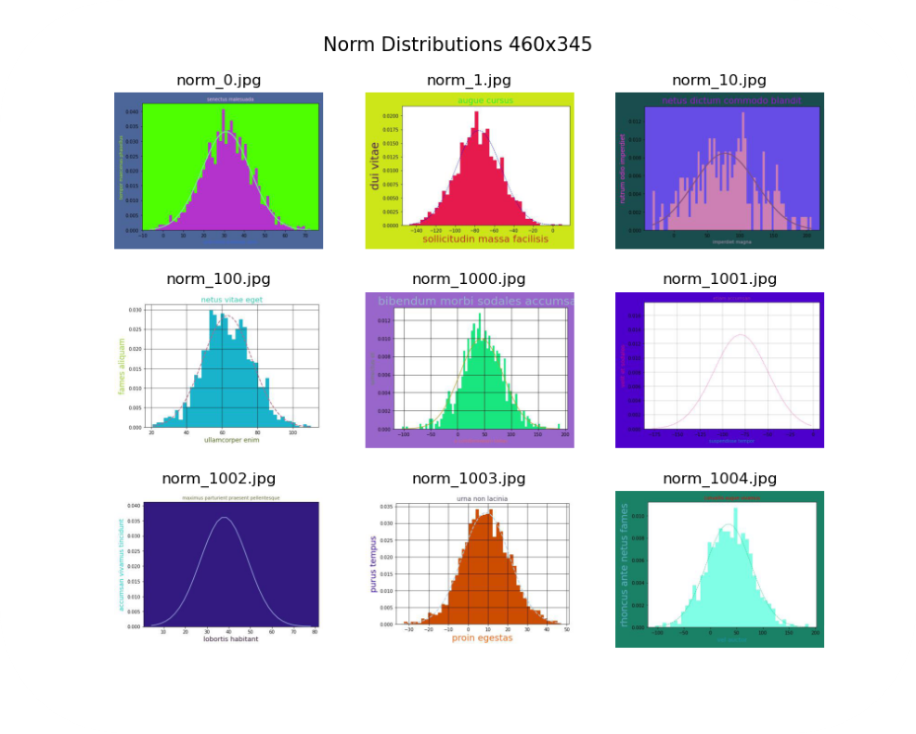
Data
Generated Graphs
Generated Overview (GEN)
My own dataset
Count – 8,000
Dimensions – 460x345
Format - JPG
4 Classes – norm, lognorm, exp, unif
norm: normal distribution
lognorm: log-normal distribution
exp: exponential distribution
unif: uniform distribution
Updated
Dimensions – 32x32, 115x86, 153x115

Slide 23
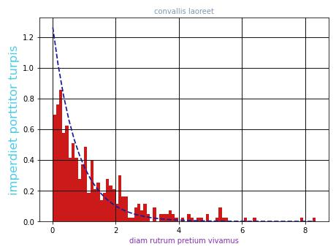
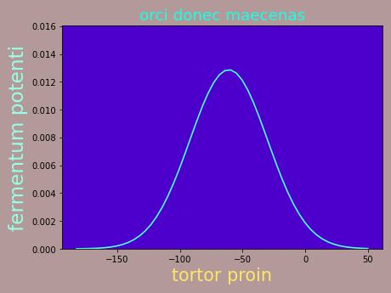
Methods
Generated Graphs
Generated Graph Design
exp_199.jpg
Randomized Design
Color – RGB (0-1 for matplotlib)
Fig and Face – RGB but biased to white
Histogram – Yes/No
Line – Yes/No
Line Style – Solid/Dash
Text – random lorum ipsum
Text Size – random
Density function parameters – random
norm_796.jpg
https://github.com/p-spohr/NN-Graph-Classifier/tree/main/graph_generators

Slide 24
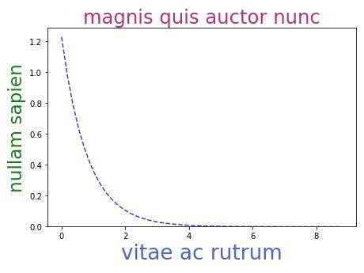
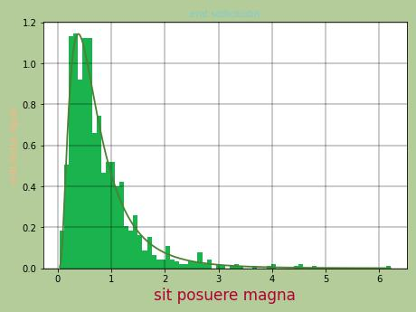
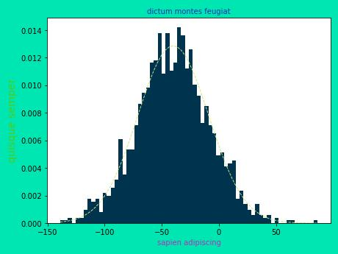
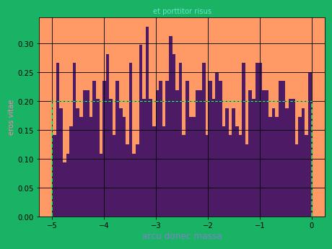
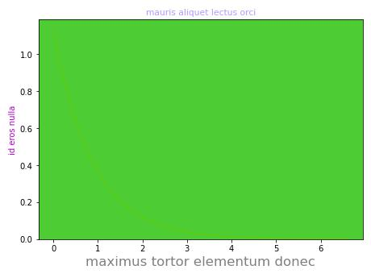
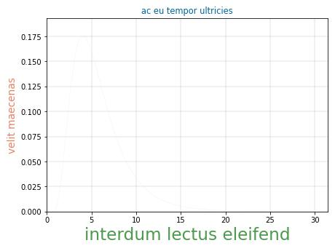
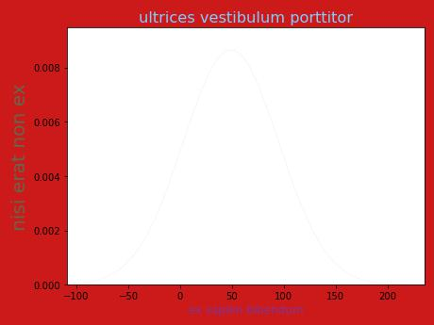
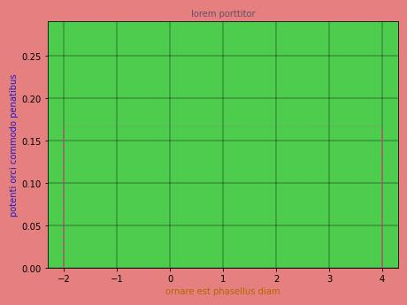
Nice vs dud Graphs
Generated Graphs
exp_146.jpg
lognorm_287.jpg
norm_226.jpg
unif_1144.jpg
exp_31.jpg
lognorm_759.jpg
norm_1506.jpg
unif_8.jpg

Slide 25











Methods
Generated Graphs
Density Functions
Normal Distribution
Log-Normal Distribution
$$f\left(x\right)=\frac{1}{σ\sqrt{2π}}e^{−\frac{1}{2}{\left(\frac{x−μ}{σ}\right)}^{2}}$$
$$f\left(x\right)=\frac{1}{xσ\sqrt{2π}}e^{−\frac{1}{2}{\left(\frac{log⁡(x)−μ}{σ}\right)}^{2}}$$
$$μ∈ ℝ$$
$$μ∈ ℝ$$
$$σ∈ℝ_{+}$$
$$σ∈ℝ_{+}$$
Exponential Distribution
Uniform Distribution
$$f\left(x\right)={λe}^{−λx}$$
$$λ∈ℝ_{+}$$
$$f\left(x\right)=\frac{1}{b−a}$$
$$a,b ∈ ℝ$$
$$a <b$$

Slide 26
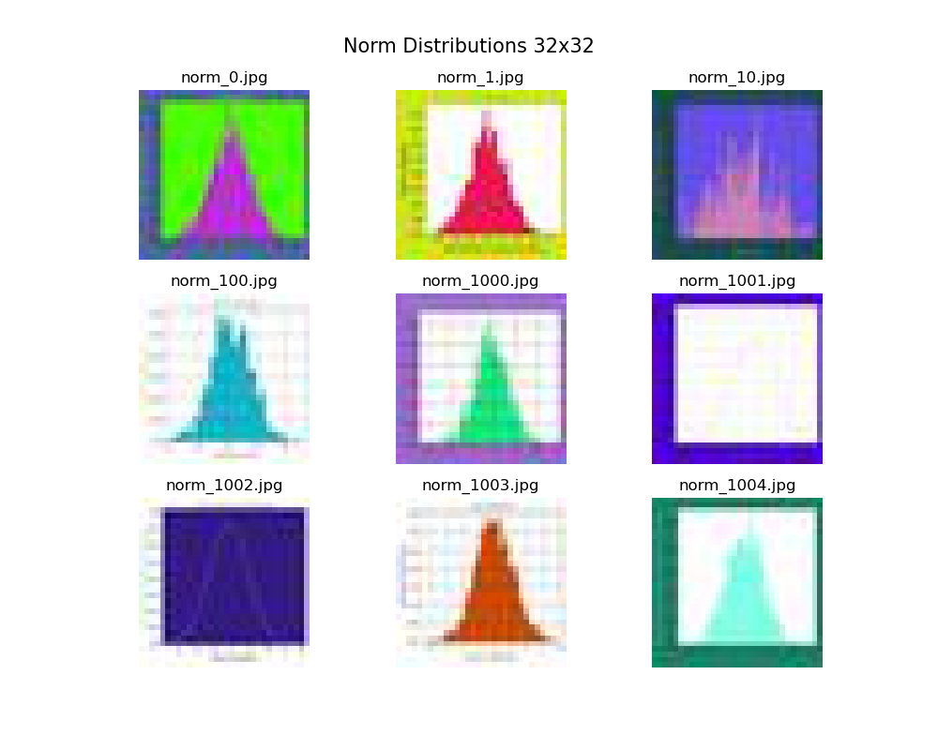
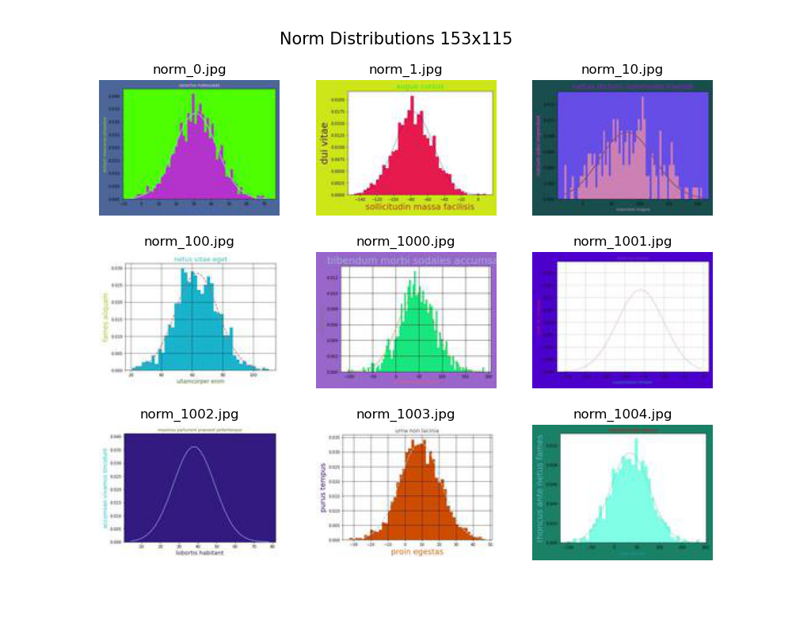

Methods
Generated Graphs
Generated Graphs Overview
Different Image Dimensions
subfolder
32x32
153x115
115x186

Slide 27
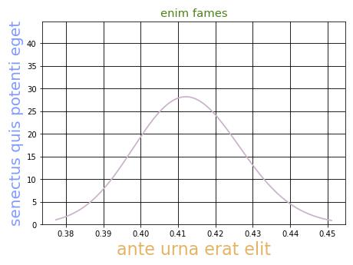
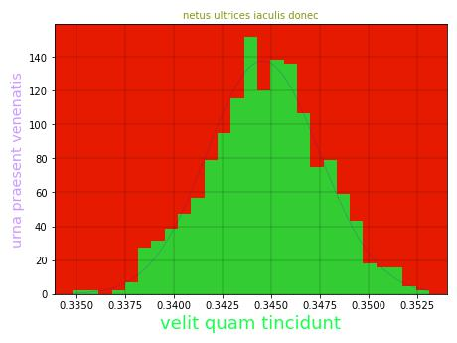
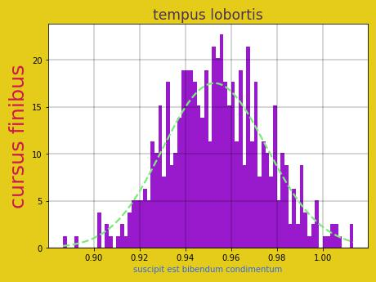
Methods
Generated Graphs
Pre-identifying possible misclassifications
Log-Normal vs. Normal Graphs
Which graph has the log-normal distribution?

Slide 28
Methods

Slide 29
Methods
Overview of how the goals were accomplished
Reviewed literature available on ANNs and CNNs
Familiarized myself with TensorFlow, Keras, and Pillow (Python library for images)
Found natural images (CIFAR) and scraped images (SCP)
Generated graph dataset (GEN) in 32x32, 115x86, 153x115
Trained Simple Graph Classifiers using CIFAR, SCP, GEN datasets
Evaluated models using untrained images
Trained Distribution Graph Classifiers using 32x32, 115x86, 153x115
Evaluated models to see where they misclassified
Tested untrained images with 153x115

Slide 30
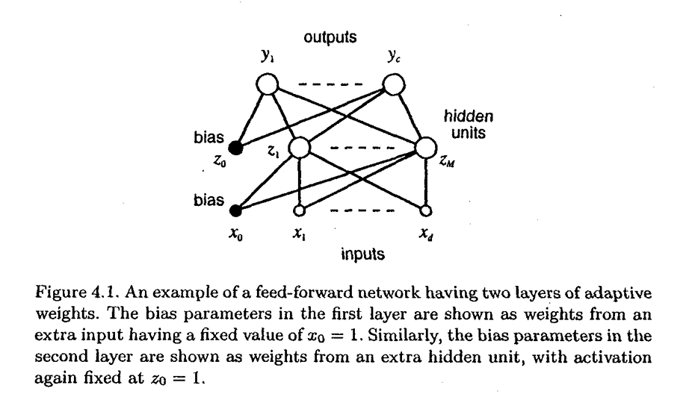
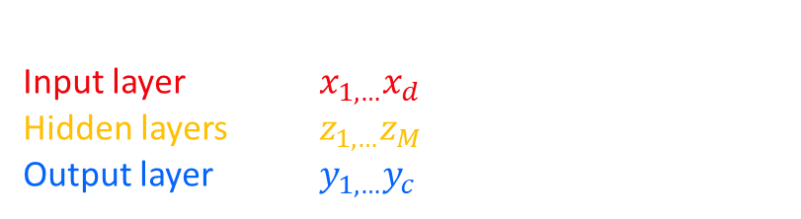
Methods
Feed-Forward Neural Networks
„We shall view feed-forward neural networks as providing a general framework for representing non-linear functional mappings between a set of input variables and a set of output variables.“
[Bishop, 117]
Three main parts for a neural network:
Input layer $x_{1,…}x_{d}$
Hidden layers $z_{1,…}z_{M}$
Output layer $y_{1,…}y_{c}$

Slide 31






Methods
Feed-Forward ANN
[Bishop, 116-119]
Output of the hidden-unit
Output of the network
$$a_{j}=\sum_{i=1}^{d}{w_{ji}^{\left(1\right)}x_{i}+w_{j0}^{\left(1\right)}}$$
$$a_{k}=\sum_{j=1}^{M}{w_{kj}^{\left(2\right)}z_{i}+w_{k0}^{\left(2\right)}}$$
d: Inputs
M: Hidden-Units
$w_{ji}^{\left(1\right)}$ weight in first layer
$w_{j0}^{\left(1\right)}$ bias for hidden unit j
Complete function for figure 4.1
$\tilde{g}\left(∙\right)$ activation function for the output units
$$a_{k}=\tilde{g}\left(\sum_{j=1}^{M}{w_{kj}^{\left(2\right)}g\left(\sum_{i=1}^{d}{w_{ji}^{\left(1\right)}x_{i}}\right)}\right)$$
$g\left(∙\right)$ activation function
$$z_{j}=g(a_{j})$$
$$y_{k}=\tilde{g}(a_{k})$$
kth output unit

Slide 32
Methods
CNN, TensorFlow, and Python
ANN vs. CNN
CNN and ANN Similarities
Feed-Forward ANN architecture
Dot product used for input and weights
Back-Propagation functions the same
The biggest difference between CNNs (convolutional neural networks) and ANNs (artificial neural networks) is that they are mostly used in image classification.
CNNs enable encoded image-specific features into the architecture (location + color), making the network more suited for image-focused tasks while also reducing the parameters required to set up the model.
CNN and ANN Differences
Shape of input is based on images (H, W, RGB)
Convolutional and pooling layers used
ReLu activation is often used
Neurons within a layer only connect to a small region of the layer preceding it.
[O’Shea et al.]

Slide 33

Methods
CNN, TensorFlow, and Python
Convolutional Neural Network
Layer by layer overview of using CNN to classify a car
[CS231n]

Slide 34
Methods
CNN, TensorFlow, and Python
CNN Summary
Layers of CNNs:
Input layer – take pixel values of image (HEIGHT, WIDTH, RGB)
Convolutional layer – determines the output of neurons of which are connected to local regions of the input through the calculation of the scalar product between their weights and the region connected to input volume
Rectified linear unit (ReLu) – aims to apply an ‘elementwise’ activation function such as sigmoid to the output of the activation produced by the previous layer
Pooling layer – downsampling along the spatial dimensionality of the given input, reducing number of parameters within that activation
Fully-connected layers (output layer) – performs the same duties found in standard ANNs and attempts to produce class scores from the activations to be used for classification
[O’Shea et al.]

Slide 35
Methods
CNN, TensorFlow, and Python
How to Understand CNN?
…first understand the input.
Images have a shape of (X, Y, RGB) where RGB determines the color.
Each color consist of a combination of red, green and blue.
(255, 255, 255)
(255, 0, 0)
(0, 255, 0)
(0, 0, 255)
(0, 0, 0)

Slide 36
Methods
CNN, TensorFlow, and Python
We are working with tensors instead of matrices now.
Dimensions and RGB
Now we can look at the shape.
( ((255, 255, 255), (0, 0, 0)),
((0, 0, 0), (255, 255, 255)) )
( (0, 0, 0) )
( (255, 255, 255), (0, 0, 0) )
(1,1,3)
(1,2,3)
(2,2,3)

Slide 37

Methods
CNN, TensorFlow, and Python
Image Quiz
Can you correctly write out this image as a tensor?
Red (255, 0, 0)
Green (0, 255, 0)
Blue (0, 0, 255)
White (255, 255, 255)
Black (0, 0, 0)
Also, what is its shape?
Answer

Slide 38
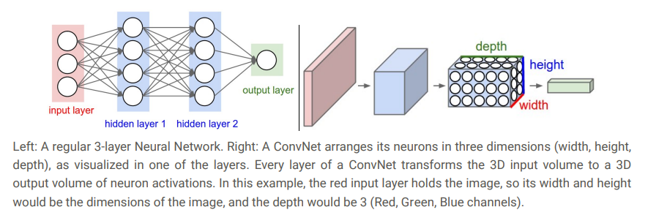
Methods
CNN, TensorFlow, and Python
Convolutional Layer
The original image gets transformed layer by layer from the original pixel values to the final class scores.
By the output layer the full image will be reduced into a single vector of class scores, arranged along the depth dimension.
Example:
The final output layer for CIFAR-10 would have dimensions of 1x1x10.
[CS231n]
Most Important Parts:
Filter – number of output filters
Kernel – size of the filter
Stride – number of pixels the kernel slides
Padding – how zeros are added

Slide 39
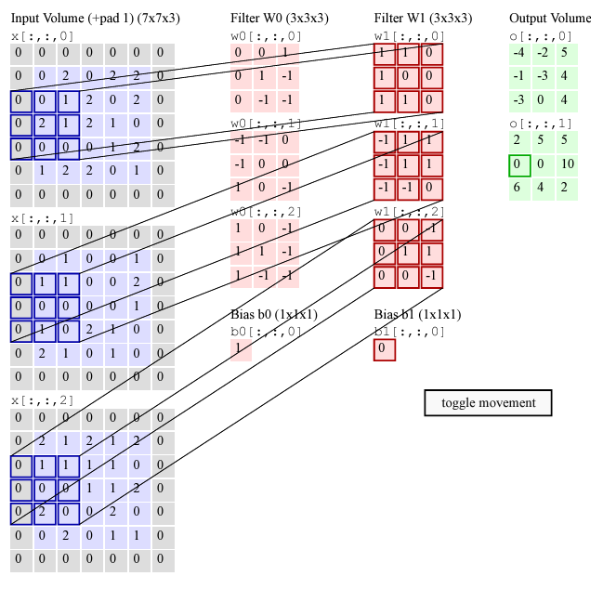
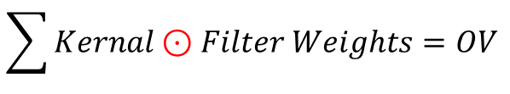


Methods
CNN, TensorFlow, and Python
R
Convolutional Layer
$$Output Volume Size=\frac{\left(W−F+2P\right)}{S}+1$$
W := input volume size
F := receptive field size (kernel)
P := amount of zero padding
S := stride of filter
K := filter count
G
Example:
Width = 5
Height = 5
RGB = 3
K = 2
F = 3
S = 2
P = 1
B
$$\sum{Kernal⊙Filter Weights=OV }$$
$$OVS=\frac{\left(5−3+2∙1\right)}{2}+1=3$$
elementwise
[CS231n]

Slide 40
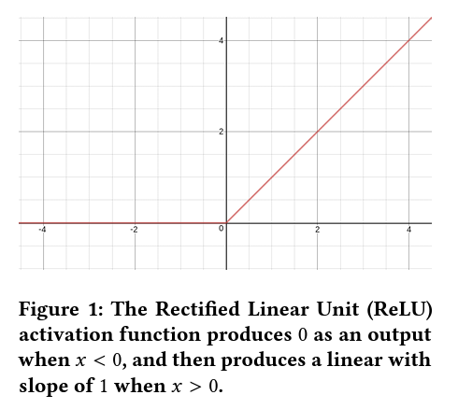

Methods
CNN, TensorFlow, and Python
Rectified Linear Units (ReLU)
$$f\left(x\right)=x^{+}=max\left(0,x\right)=\frac{x+\left|x\right|}{2}=\left\{\begin{aligned}x if x>0, \\ 0 otherwise,\end{aligned}\right.$$
Why ReLu?
eliminates complex calculations
reduces processing demands
model can learn in less time
promotes sparsity
Sparsity refers to a scenario where most of the cell entries in a matrix are zero [Giskard].
[Agarap]

Slide 41
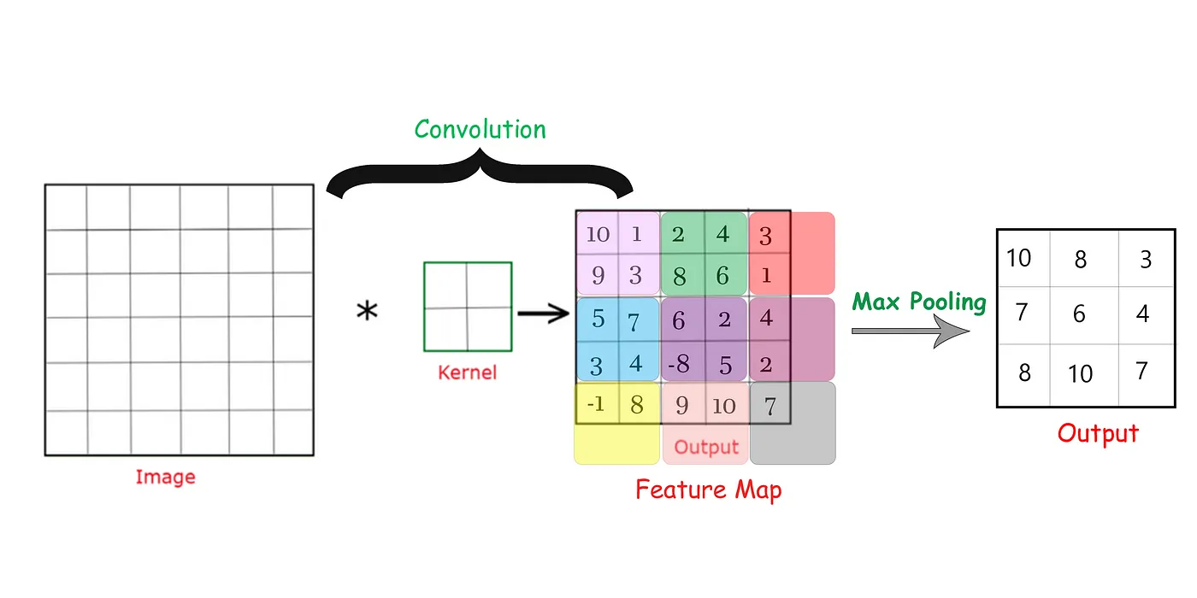
Methods
CNN, TensorFlow, and Python
Max Pooling
Maximum pooling calculates the maximum, or largest, value in each patch of each feature map.
The feature map output of convolutional layers record the precise position of features in the input. Small movements in the position of the feature will result in a different feature map.
$$MP=max\left(f_{i}\right) for i=1,…,F feature map patches$$
Downsampling:
lower resolution version of an input signal is created
contains the large or important structural elements without the fine detail that may not be as useful
[Brownlee]
[Kumar, Credit: Codicals]

Slide 42


Methods
CNN, TensorFlow, and Python
The cross-entropy loss function in classification calculates how accurate our machine learning or deep learning model is by defining the difference between the estimated probability with our desired outcome.
[The 365 Team]
Binary Cross-Entropy Loss
Only two classes
$$BCEL=−\frac{1}{M}\sum_{i=1}^{M}{\left(y_{i}log\left(p_{i}\right)+\left(1−y_{i}\right)log\left(1−p_{i}\right)\right)}$$
M := number of classes
y := indicator if class label j is the correct classification for observation i
p := predicted probability observation i is of class j
Categorical Cross-Entropy Loss
More than two classes
$$CCEL=−\frac{1}{M}\sum_{i=1}^{M}{\sum_{j=1}^{C}{y_{i,j}∙log⁡(p_{i,j}})}$$

Slide 43
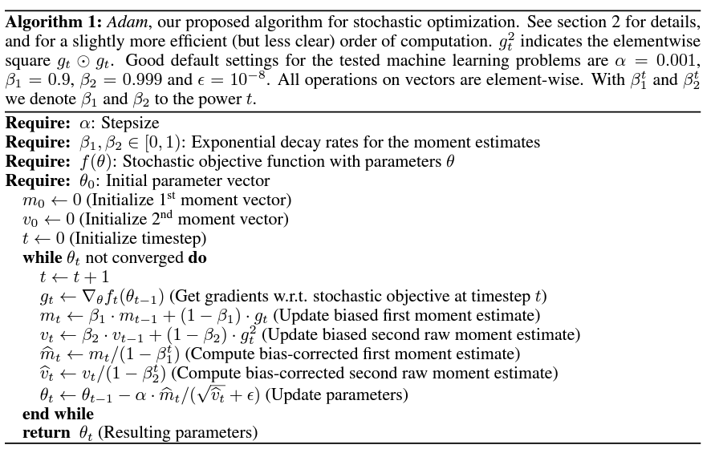
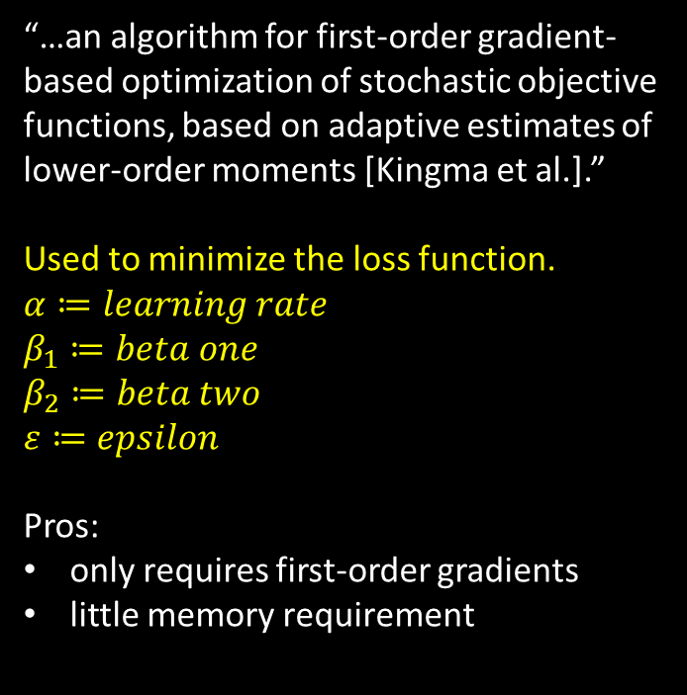
Methods
CNN, TensorFlow, and Python
minimizes the loss function during the training of neural networks
Adam Optimizer
“…an algorithm for first-order gradient-based optimization of stochastic objective functions, based on adaptive estimates of lower-order moments [Kingma et al.].”
Used to minimize the loss function.
$$α≔learning rate$$
$$β_{1}≔beta one$$
$$β_{2}≔beta two$$
$$ε≔epsilon$$
Pros:
only requires first-order gradients
little memory requirement
[Kingma et al.]

Slide 44


TensorFlow + Keras API
Methods
CNN, TensorFlow, and Python
TensorFlow – end-to-end platform for building ML models
Keras – deep learning API written in Python (compatible with TensorFlow)
https://www.tensorflow.org/api_docs/python/tf
https://keras.io/api/

Slide 45




Python + libraries
Methods
CNN, TensorFlow, and Python
NumPy – math + ndarray + random
pandas – data handling
Matplotlib – graphing
Pillow – image processing
(TensorFlow returns PIL.Image)
https://numpy.org/doc/stable/reference/index.html
https://matplotlib.org/stable/index.html
https://pandas.pydata.org/docs/reference/index.html
https://pillow.readthedocs.io/en/stable/

Slide 46
Library Versions
Methods
CNN, TensorFlow, and Python
Other Programs Used
python 3.10.13
tensorflow 2.10.0
numpy 1.26.0
pandas 2.1.1
matplotlib 3.8.0
pillow 10.0.1
Visual Studio Code (code editor)
Anaconda (Python environments)
Jupyter Notebook (interactive code)

Slide 47
Methods
Simple Graph Classifiers
CIFAR: natural images
Total = 10000
SCP: scraped graphs
Total = 7753
GEN: generated graphs
Total = 8000
1: Model 1
CIFAR_SCP_1
x = 32x32 images
y = [graph, natural]
Total = 17753
Train = 14203
Val = 3550
GEN_SCP_1
x = 32x32 images
y = [generated, scraped]
Total = 15753
Train = 12603
Val = 3150
CIFAR_GEN_1
x = 32x32 images
y = [graph, natural]
Total = 18000
Train = 14400
Val = 3600
CIFAR_GEN_SCP_1
x = 32x32 images
y = [generated, natural, scraped]
Total = 25753
Train = 20603
Val = 5150
https://github.com/p-spohr/NN-Graph-Classifier/tree/main/classifiers/simple_graph_classifiers

Slide 48

Methods
Simple Graph Classifiers
1: Model 1
Same model for simple graph classifiers and distribution graph classifiers.
"same" results in padding with zeros evenly to the left/right or up/down of the input.

Slide 49

Methods
CIFAR_GEN_1
Image examples
Simple Graph Classifiers
Input layer := x = (32, 32, 32, 3)
y = graph
y = natural

Slide 50


Load image datasets
Methods
Simple Graph Classifiers
CIFAR_SCP_1 & CIFAR_GEN_1
tf.keras.utils.image_dataset_from_directory(
directory,
labels='inferred’, # subfolder names
label_mode='int',
class_names=None,
color_mode='rgb’, # jpg has no alpha
batch_size=32,
image_size=(32, 32), # (height, width)
shuffle=True,
seed=None,
validation_split=None, # 0-1 for validation
subset=‘both’, # ‘both’ returns (‘train’, ‘val’)
interpolation='bilinear',
follow_links=False,
crop_to_aspect_ratio=False,
**kwargs
)
CIFAR_GEN_SCP_1
https://www.tensorflow.org/api_docs/python/tf/keras/utils/image_dataset_from_directory

Slide 51




Methods
Simple Graph Classifiers
Code Steps Overview
Similar steps for all models except the datasets and targets are different
1) Initialize constant parameters and directory path
2) Get dataset from directory path
3) Build model
4) Compile and fit model to data
https://github.com/p-spohr/NN-Graph-Classifier/blob/main/classifiers/simple_graph_classifiers/CIFAR_GEN_1.py

Slide 52
CIFAR_GEN_1 Summary
Model: "sequential"
Layer (type) Output Shape Param #
=================================================================
rescaling (Rescaling) (None, 32, 32, 3) 0
conv2d (Conv2D) (None, 32, 32, 16) 448
max_pooling2d (MaxPooling2D (None, 16, 16, 16) 0
)
conv2d_1 (Conv2D) (None, 16, 16, 32) 4640
max_pooling2d_1 (MaxPooling (None, 8, 8, 32) 0
2D)
conv2d_2 (Conv2D) (None, 8, 8, 64) 18496
max_pooling2d_2 (MaxPooling (None, 4, 4, 64) 0
2D)
flatten (Flatten) (None, 1024) 0
dense (Dense) (None, 128) 131200
dense_1 (Dense) (None, 2) 258
=================================================================
Total params: 155,042
Trainable params: 155,042
Non-trainable params: 0
_________________________________________________________________

Slide 53
Methods
Distribution Graph Classifiers
DIST = distribution classifier
*WIDTH x HEIGHT = dimensions of image
1 = Model 1
Input
DIST_32x32_1
x = 32x32 images
Total = 8000
Train = 6400
Val = 1600
DIST_115x86_1
x = 115x86 images
y = [exp, lognorm, norm, unif]
DIST_153x115
x = 153x115 images
*IMPORTANT: dimensions are reversed in TensorFlow
input_shape = (HEIGHT, WIDTH)
https://github.com/p-spohr/NN-Graph-Classifier/tree/main/classifiers/distribution_graph_classifiers

Slide 54
Results

Slide 55
Results Overview
Simple Graph Classifiers
Distribution Graph Classifiers
CIFAR_SCP_1
CIFAR_GEN_1
GEN_SCP_1
CIFAR_GEN_SCP_1
DIST_32x32_1
DIST_115x86_1
DIST_153x115_1

Slide 56
Simple graph classifiers
Results

Slide 57

CIFAR_SCP_1
Natural Images and Scraped Graphs
97.55%
High validation accuracy after 3 epochs

Slide 58

CIFAR_GEN_1
Natural Images and Generated Graphs (my graphs)
99.89%
Even my generated graphs can be classified accurately

Slide 59

GEN_SCP_1
Generated Graphs and Scraped Graphs
99.21%
This was surprising! The generated graphs are quite distinguishable from the scraped graphs

Slide 60

CIFAR_GEN_SCP_1
Natural Images, Generated Graphs, and Scraped Graphs
98.12%
For good measure –a model to classify all three

Slide 61
Evaluations
Can the models predict if an image from the other graph dataset is a graph or not?
Generated Graphs in CIFAR_SCP_1
Scraped Graphs in CIFAR_GEN_1
Prediction | Count
True (graph) | 6475
False (natural) | 1525
Prediction | Count
True (graph) | 2886
False (natural) | 4867
Accuracy: 80.9375%
Accuracy: 37.2243%
Best case is 100% accuracy
When graphs from the scraped dataset are put into the CIFAR_GEN_1, it predicts most of them are natural images.

Slide 62

Evaluations
What does this mean?
Graphs with a uniform distribution were most often labelled as a natural image.

Slide 63








Misclassification as natural
Misclassified Exp
exp_20
exp_202
exp_392
exp_730
Misclassified Lognorm
lognorm_237
lognorm_544
lornorm_918
lognorm_1344

Slide 64








Misclassification as natural
Misclassified Norm
norm_399
norm_695
norm_1185
norm_1929
Misclassified Unif
unif_18
unif_352
unif_763
unif_1436

Slide 65
Distribution graph classifiers
Results

Slide 66

DIST_32x32_1
Distribution Graphs of Dimension 32x32
79.25%
The model struggled more to classify the graphs, but still managed almost 80% validation accuracy after 10 epochs

Slide 67

DIST_115x86_1
Distribution Graphs of Dimension 115x86
93.00%
Increasing the quality of the image greatly increased accuracy

Slide 68

DIST_153x115_1
Distribution Graphs of Dimension 115x86
93.50%
Diminishing return in regards of image quality since the validation accuracy only improved by 0.5% to 93.5% from the 115x86 images.

Slide 69
Evaluation Overview
The model can’t consistently classify ~7% of the images when validating. What are the that are getting misclassified?
Accuracy is 96.5375% with a total of 270 misclassifications
Exp in DIST_153x115_1
Lognorm in DIST_153x115_1
Prediction | Count
True (exp) | 1851
False (other) | 149
Prediction | Count
True (lognorm) | 1925
False (other) | 75
Accuracy: 92.55%
Accuracy: 96.25%
Norm in DIST_153x115_1
Unif in DIST_153x115_1
Prediction | Count
True (norm) | 1960
False (other) | 40
Prediction | Count
True (unif) | 1994
False (other) | 6
Accuracy: 98.00%
Accuracy: 99.70%

Slide 70

Misclassifications
What does this mean?
Graphs with an exponential distribution were most often labelled incorrectly.

Slide 71




Deeper Dive

Slide 72

Misclassification Results csv
In order to understand the results better I created a CSV with relevant information.
Here is the misclassification of exponential distribution graphs as lognormal.
Ending prediction weights per class
Correct?
File name
Labeled based on max

Slide 73








Misclassification of Exp as Lognorm
Bonus: Exp as Unif
exp_313 = 9.7 prediction
exp_502 = 11.5
exp_578 = 9.5
exp_1782
exp_1142
exp_724 = 12.7
exp_883 = 11.2
exp_1021 = 10.6

Slide 74





Misclassification of Norm as Lognorm
norm_53 = 6.7 prediction
norm_193 = 8.9
norm_194 = 7.5
norm_1082 = 11.6

Slide 75





Misclassification of Lognorm as norm
lognorm_520 = 9.1 prediction
lognorm_710 = 11.5
lognorm_972 = 6.2
lognorm_1301 = 10.6

Slide 76





Misclassification of unif
unif_451 as lognorm
unif_466 as norm
unif_609 as exp
unif_642 as exp
Not very surprising that these graphs are labeled seemingly randomly since they are mostly blank.
But it is impressive that there are only 6 misclassified unif graphs considering the amount that look like these.

Slide 77

Final Test Evaluation
In order to truly evaluate my generated graphs and models, I needed to use graphs that were not used before.
Exp 20 (new scraped) + 1 (hand-drawn)
Lognorm 20 + 1
Norm 20 + 1
Unif 20 + 1
Test images in DIST_153x115_1
Prediction | Count
True | 52
False | 36
Accuracy: 59.091%
Most incorrectly classified graphs were misclassified as lognorm
Best case is 100% accuracy

Slide 78



Final Test Evaluation
Misclassified Exp Graphs
40% of exp graphs were misclassified as lognorm
exp_hand_0
Misclassified Lognorm Graphs
Only two misclassifications of lognorm graphs

Slide 79







Final Test Evaluation
Misclassified
norm_8
norm_11
norm_13
norm_15
norm_hand_0
True
Norm = 13.159
Lognorm = 8.398
Correctly Predicted

Slide 80

Final Test Evaluation
Misclassified Unif Graphs
It was surprising how 65% of unif graphs in the test dataset were misclassified as lognorm since the generated unif graphs were predicted so accurately.
Unif in DIST_153x115_1
Prediction | Count
True (unif) | 1994
False (other) | 6
Accuracy: 99.70%

Slide 81
Conclusion

Slide 82
Conclusion
Overall Goals Accomplished
can successfully identify graphs from natural images with greater than ~98% accuracy
can successfully identify graphs with different distribution types with ~93% accuracy
Some Surprising Results
scraped graphs in CIFAR_GEN_1 are misclassified as natural images ~63% of the time
This enforces my idea that many of the images in SCP were more ‘graph-like’ and not graphs
unif in DIST_153x115_1 were classified accurately ~99% of the time, but 20% of unif graphs in CIFAR_SCP_1 were misclassified as natural images
Graphs with the uniform distribution were very unique from the other distribution graphs but not very unique from natural images

Slide 83

More Preprocessing Considerations to Improve Results
Conclusion
tf.keras.layers.RandomBrightness()
tf.keras.layers.RandomContrast()
tf.keras.layers.RandomCrop()
tf.keras.layers.RandomFlip()
tf.keras.layers.RandomRotation()
model = tf.keras.Sequential([
layers.Rescaling(1./255,
# add more randomness to images after rescaling
])
https://www.tensorflow.org/api_docs/python/tf/image/random_brightness

Slide 84

Conclusion
Further Research and Improvement
Change model structure
Use more images to train models
Improve generated graphs
Add more distributions
Use entire reports as input and identify pages with graphs on them
[O’Shea et al.]

Slide 85

DIST_32x32_2
Distribution Graphs of Dimension 32x32
Epochs = 20
82.62%
Epochs = 10
80.5%
By doubling the number of filters in the convolution layers to see minor improvements after but we start to run into the issue of overfitting
79.25% for DIST_32x32_1
After 10 Epochs.

Slide 86
References (1/4)
Abadi, M., Barham, P., Chen, J., Chen, Z., Davis, A., Dean, J., . . . Google Brain. (2016). TensorFlow: A system for large-scale machine learning. 12th USENIX Symposium on Operating Systems Design and Implementation (pp. 265-283). Savannah, GA, USA: USENIX Association.
Agarap, A. F. (2019). Deep Learning using Rectified Linear Units (ReLU). San Diego: 3rd International Conference for Learning Representations. Retrieved from https://arxiv.org/abs/1803.08375
Bishop, C. M. (1995). Neural Networks for Pattern Recognition. Oxford: Clarendon Press. Retrieved from https://www.microsoft.com/en-us/research/uploads/prod/2006/01/Bishop-Pattern-Recognition-and-Machine-Learning-2006.pdf
Brownlee, J. (2019, July 05). A Gentle Introduction to Pooling Layers for Convolutional Neural Networks. Retrieved from Machine Learning Mastery: https://machinelearningmastery.com/pooling-layers-for-convolutional-neural-networks/
Clark, A. (2015). Pillow (PIL Fork) Documentation. readthedocs. Retrieved from https://buildmedia.readthedocs.org/media/pdf/pillow/latest/pillow.pdf

Slide 87
References (2/4)
CS231n. (2023). (Stanford University) Retrieved January 2024, from Convolutional Neural Networks for Visual Recognition: https://cs231n.github.io/convolutional-networks/
Giskard. (n.d.). Rectified Linear Unit (ReLU). Retrieved from Giskard: https://www.giskard.ai/glossary/rectified-linear-unit-relu
Harris, C. R., Millman, K. J., van der Walt, S. J., Gommers, R., Virtanen, P., Cournapeau, D., … Oliphant, T. E. (2020). Array programming with NumPy. Nature, 585, 357–362. https://doi.org/10.1038/s41586-020-2649-2
Hunter, J. D. (2007). Matplotlib: A 2D graphics environment. Computing in Science &amp; Engineering, 9(3), 90–95.
Kamakshi, V., & Krishnan, N. C. (2023, August 1). Explainable Image Classification: The Journey So Far and the Road Ahead. 4, 620–651. Retrieved from https://doi.org/10.3390/ai4030033
Kingma, D. P., & Ba, J. L. (2015). Adam: A Method for Stochastic Optimization. ICLR. Retrieved from https://arxiv.org/abs/1412.6980

Slide 88
References (3/4)
Krizhevsky, A., Nair, V., & Hinton, G. (2009). The CIFAR-10 dataset. Retrieved from Canadian Institute For Advanced Research: https://www.cs.toronto.edu/~kriz/cifar.html
Kumar, P., & Codicals. (2021, August 24). Max Pooling, Why use it and its advantages. Retrieved from Medium: https://medium.com/geekculture/max-pooling-why-use-it-and-its-advantages-5807a0190459
Li, L. (2018, March 23). Data Visualization. Retrieved from Medium: https://medium.com/@Lynia_Li/as-you-know-there-are-many-types-of-charts-to-be-used-in-data-visualization-54da9b97092e
McDonald's. (2022). 2022 Annual Report. Retrieved from https://corporate.mcdonalds.com/content/dam/sites/corp/nfl/pdf/MCD_2023_Annual_Report.pdf
McKinney, W., & others. (2010). Data structures for statistical computing in python. In Proceedings of the 9th Python in Science Conference (Vol. 445, pp. 51–56).
O'Shea, K., & Nash, R. (2015). An Introduction to Convolutional Neural Networks. Aberystwyth University. ResearchGate. Retrieved from: https://doi.org/10.48550/arXiv.1511.08458

Slide 89
References (4/4)
SandhyaKrishnan02. (2023). An overview of probability distribution. Retrieved from Kaggle: https://www.kaggle.com/discussions/general/366492
SunEdition. (2021). Graphs Dataset. Retrieved from Kaggle: https://www.kaggle.com/datasets/sunedition/graphs-dataset
The 365 Team. (2023, June 15). What Is Cross-Entropy Loss Function? Retrieved from 365DataScience: https://365datascience.com/tutorials/machine-learning-tutorials/cross-entropy-loss/

Slide 90
Thank you
Patrick Spohr
HTW Berlin – FAR Master‘s
Deep Learning Seminar
Prof Dr Alla Petukhina

Slide 91

Answer
Image Quiz
( ( (0, 0, 255), (0, 255, 0), (255, 255, 255) ),
( (255, 0, 0), (0, 0, 255), (255, 0 , 0) ),
( (0, 0, 0), (255, 255, 255), (0, 255, 0) ) )
(3, 3, 3)

